Slide 1


Small area estimation with calibration methods
Risto Lehtonen (University of Helsinki) Ari Veijanen (Statistics Finland)
10ème Colloque Francophone sur les sondages - Lyon 24 au 26 octobre 2018

Slide 2
Outline
Preliminaries
Calibration weighting systems
Monte Carlo experiments
Discussion
Literature
This is joint work with my colleague Dr Ari Veijanen of Statistics Finland

Slide 3
Design-based calibration methods for domain estimation to be discussed
Traditional model-free calibration MFC
Deville J.-C. and Särndal C.-E. (1992), Särndal C.-E. (2007)
Deville J.-C., Särndal C.-E. and Sautory (1993) (CALMAR I,II,...)
Estevao & Särndal (1999, 2004), Lehtonen & Veijanen (2009)
Model-assisted calibration MC
Lehtonen & Veijanen (2012, 2016)
Wu & Sitter (2001), Montanari & Ranalli (2005) (Model calibration)
Hybrid calibration HC
Lehtonen & Veijanen (2015)
Montanari & Ranalli (2009) (Multiple model calibration)
Two-level hybrid calibration HC2
Lehtonen and Veijanen (2017)

Slide 4
Some key properties (under complete response)

Slide 5
Questions of interest
Relative design-based properties of MFC, MC, HC and HC2
Accuracy properties
Distributional properties of calibrated weights
Comparison with model-based SAE
Design bias and accuracy of model-assisted calibration vs. model-based EB method
Main interest: What happens in minor domains (with small domain sample size)?
Empirical framework Design-based simulation experiments
Real population data
Mixed models

Slide 6
Target parameters

Slide 7
Sample data

Slide 9
Auxiliary data

Slide 10
Assisting mixed models

Slide 11
Calibration weighting system - 1

Slide 12
Calibration weighting system - 2

Slide 13
Calibration vectors for single-level methods

Slide 14
Two-level hybrid calibration - 1

Slide 16
Two-level hybrid calibration - 2

Slide 17
Estimators of domain proportions

Slide 18
Model-based EB predictor

Slide 19
Some known differences

Slide 20
EXAMPLE: Poverty rate for regions
Design-based simulation experiment with real data
Fixed finite population of about 600,000 persons Western Finland Register databases of Statistics Finland
Regional hierarchy: NUTS4 (LAU1) regions within NUTS3 regions
Domains of interest: 36 NUTS4 regions Higher level regions: 7 NUTS3 regions
SRSWOR sampling of n = 2000 persons
Limited simulation experiments
Calibration methods: K=1000 simulated samples
Weight distributions: K=100 simulated samples

Slide 21
Variables
Study variable y:
Binary indicator with values 1=in poverty, 0=otherwise
European Union definition, one of the AROPE indicators: The poverty indicator shows when a person’s equivalized income is smaller than or equal to the poverty threshold, 60% of the median equivalized income in the population
Equivalized income variable was taken from taxation registers
Overall poverty rate in population: 14.3% lowest(NUTS4): 9.9%, highest(NUTS4): 22.4%
Auxiliary x-variables
Labour force status (3 classes)
Gender (2 classes)
Age group (3 classes)
We generated five indicator variables for the x-vector

Slide 22
Estimators

Slide 23
Quality measures of estimators

Slide 26
Summary of results on calibration
Design bias: All estimators are nearly design unbiased
Design accuracy Major domains: All estimators show pretty similar accuracy
Minor and medium-sized domains: Model-assisted methods outperform direct model-free calibration
Model-assisted calibration shows best accuracy and is preferred
Hybrid calibration offers coherence property for selected x-variables but can suffer from instability in small areas
Two-level hybrid calibration accounts for the instability and can provide a good compromise if coherence is required for some x-variables
NOTE: Preliminary results on Hájek type estimators (12) indicate that accuracy differences to HT type methods are small and exist in small domains and are systematically in favour of Hájek methods

Slide 27
Distributional properties of calibrated weights
Problems of practical concern in model-free calibration: Possible large variation of weights Weights smaller than one Positive but extremely small weights Negative weights
To what extent model-assisted calibration methods can help?
Small simulation experiment: 100 SRSWOR samples of size 2,000 elements from U
Reporting: Distribution of weights by domain size (log scale) - Figure 1
Medians of maximum interdecile range of calibrated weights in domain sample size classes - Table 3

Slide 28
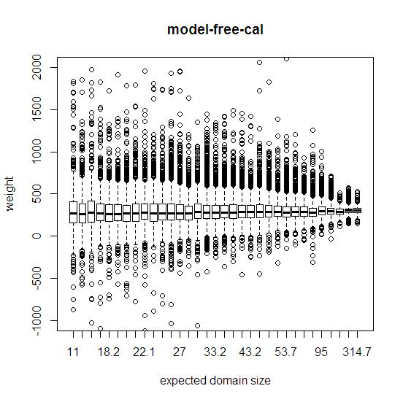
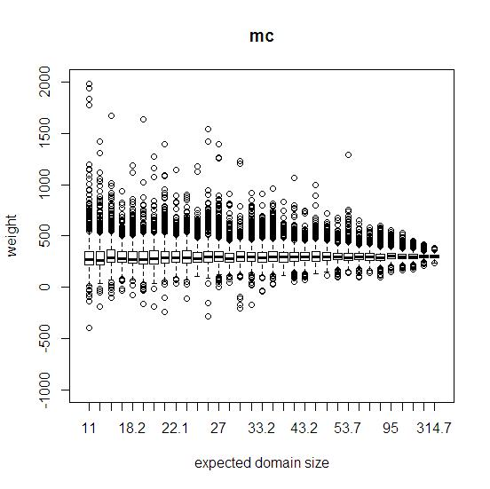
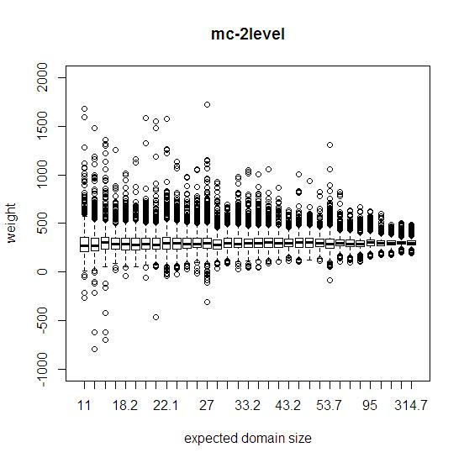
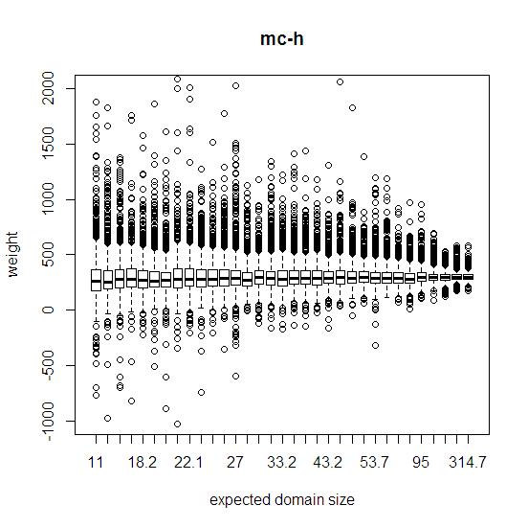
Fig. 1. Distribution of weights by domain size 100 simulated SRSWOR samples, n=2000

Slide 30
Summary of distributional properties
Model-free calibration MFC shows worst performance
Model-assisted calibration MC stabilizes substantially the distribution of weights, in small domains in particular
Model-assisted calibration MC and two-level hybrid calibration HC2 indicate best weight performance
But: negative weights still remain Can we live with that? Rather use other solutions?
--
Wu C. and Lu W.W. (2016) Calibration weighting methods for complex surveys. International Statistical Review 84, 79-98.
Gelman A. (2007) Struggles with survey weighting and regression modeling. Statistical Science 22, 153-164.
Gelman: “Survey weighting is a mess.”

Slide 32
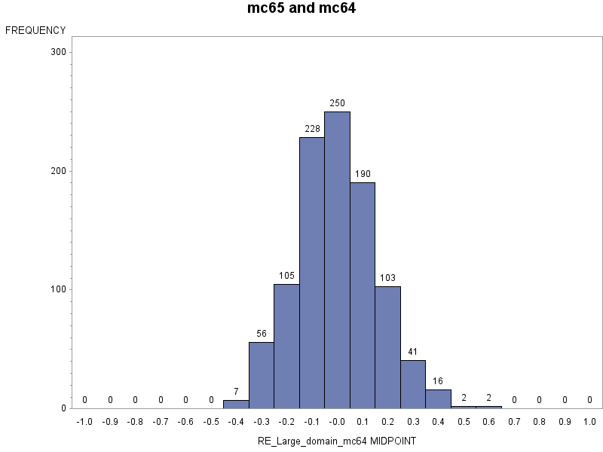
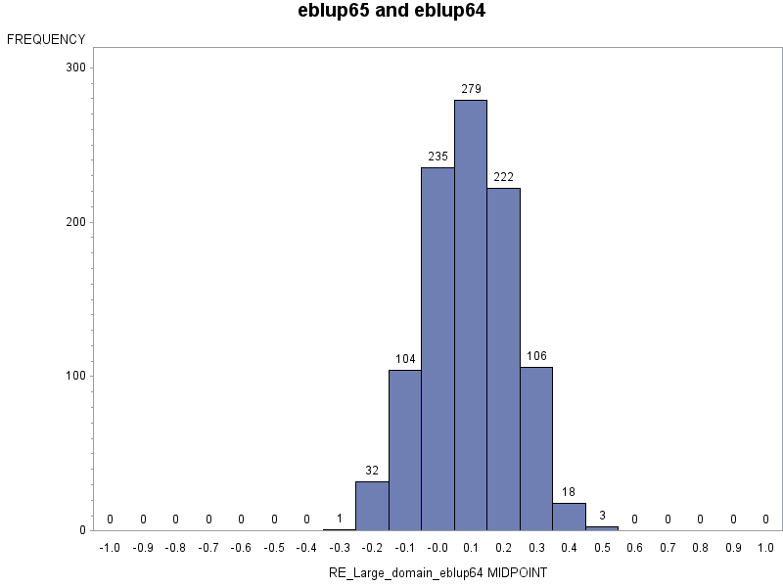
Relative error of MC and EB estimators in a certain large domain
Distribution of relative error
of design-based model assisted calibration MC estimator of poverty rate in large domain 64
NOTE Nearly design unbiased Outperforms EB in design bias
Distribution of relative error
of model-based EB estimator of poverty rate in large domain 64
NOTE
Design biased
Outperforms MC in design accuracy

Slide 33
Literature
Deville J.-C. and Särndal C.-E. (1992) Calibration estimators in survey sampling. JASA 87, 376-382.
Deville J.-C., Särndal C.-E. and Sautory O. (1993). Generalized raking procedures in survey sampling. JASA 88,1013–1020.
Estevao V.M. and Särndal C.-E. (1999) The use of auxiliary information in design-based estimation for domains. Survey Methodology 2, 213–221.
Estevao V.M. and Särndal C.-E. (2004) Borrowing strength is not the best technique within a wide class of design-consistent domain estimators. JOS 20, 645-669.
Gelman A. (2007) Struggles with survey weighting and regression modeling. Statistical Science 22, 153-164.
Guggemos F. and Tillé Y. (2010) Penalized calibration in survey sampling: Design-based estimation assisted by mixed models. Journal of Statistical Planning and Inference 140 ,3199–3212.
Hidiroglou M.A. and Estevao V.M. (2014) A comparison of small area and calibration estimators via simulation. Joint Issue of Statistics in Transition and Survey Methodology 17,133-154.
Lehtonen R. and Veijanen A. (2009) Design-based methods of estimation for domains and small areas. In Rao C.R. and Pfeffermann D. (Eds.) Handbook of Statistics 29B. Elsevier, 219-249.
Lehtonen R. and Veijanen A. (2012) Small area poverty estimation by model calibration. Journal of the Indian Society of Agricultural Statistics 66, 125-133.

Slide 34
Literature (contd.)
Lehtonen and Veijanen (2015) Small area estimation by calibration methods. WSC 2015 of the ISI, Rio de Janeiro, August 2015.
Lehtonen R. and Veijanen A. (2016) Design-based methods to small area estimation and calibration approach. In: Pratesi M. (Ed.) Analysis of Poverty Data by Small Area Estimation. Chichester: Wiley.
Lehtonen R. and Veijanen A. (2017) A two-level hybrid calibration technique for small area estimation. SAE2017 Conference, Paris, June 2017.
Montanari G.E. and Ranalli M. G. (2005) Nonparametric model calibration estimation in survey sampling. JASA 100, 1429–1442.
Montanari G.E. and Ranalli M.G. (2009) Multiple and ridge model calibration. Proceedings of Workshop on Calibration and Estimation in Surveys 2009. Statistics Canada.
Rao J.N.K. and Molina I. (2015) Small Area Estimation. 2nd Ed. New York: Wiley.
Särndal C.-E. (2007) The calibration approach in survey theory and practice. SMJ 33, 99–119.
Wu C. and Lu W.W. (2016) Calibration weighting methods for complex surveys. International Statistical Review 84, 79-98.
Wu C. and Sitter R.R. (2001) A model-calibration approach to using complete auxiliary information from survey data. JASA 96, 185–193. (with corrigenda)

Slide 35
merci beaucoup!

